Slide 1

A
Presentation
On
Hotel Review Classification
Group : 01
Mentor: Mr.Karthik
Group Members
Akshay Maskar
Saurabh Patil
Saket Sharma

Slide 2
Business Objective :
This is a sample dataset which consists of 20,000reviews and ratings for different hotels and our goal is to examine how travelers are communicating their positive and negative experiences in online platforms for staying in a specific hotel and major objective is what are the attributes that travelers are considering while selecting a hotel. With this manager can understand which elements of their hotel influence more in forming a positive review or improves hotel brand image.
Main Goal :
Users" feedback To improve and avoid negative things and keep the positives. Reviews can be analyzed to understand where a hotel failed to provide a good customer experience and where it succeed using NLP.

Slide 3
Dataset Information
Rows :
20491
Columns :
2
Column Names & Data Types
Rating
Float64
Reviews
Object
Duplicated
0
Null Values
0

Slide 4
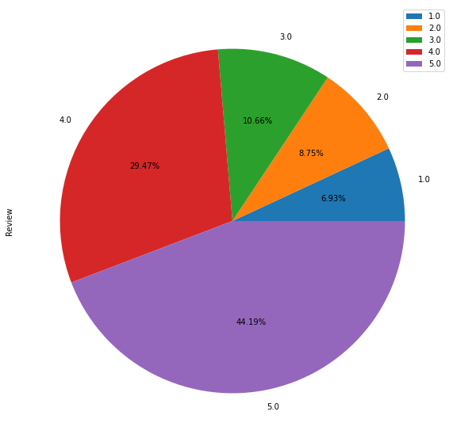

Data Visualization
From pie chart we can conclude that most review has having more than 3 rating i.e. 73.66%
Highest percentage is covered by 5 rating 44.19 and lowest is 1 rating i.e. 6.93%

Slide 5
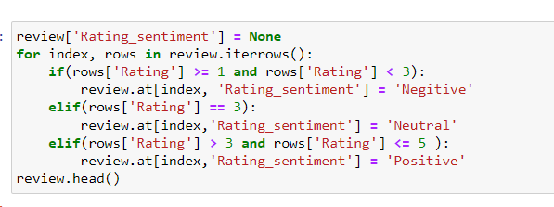
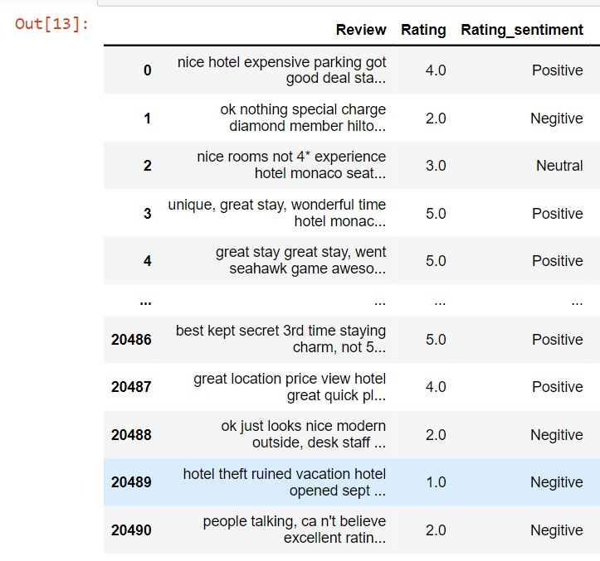
Adding Rating Sentiment Column
Code :

Slide 6
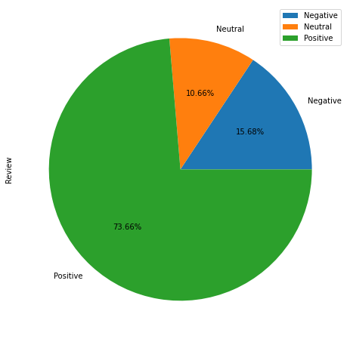
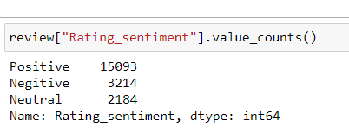

Data Analysis
For better understanding we divided rating into three parts Negative (1,2) ,Neutral (3) and Positive (4,5).

Slide 7
Data Preprocessing
1
Data Cleaning
2
Lemmatization
3
Stemming

Slide 8
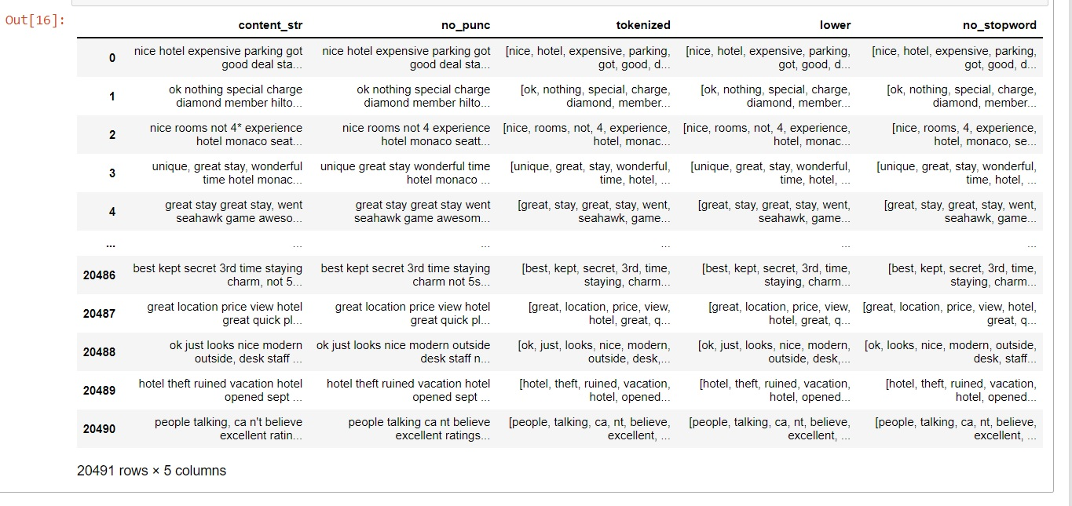
EDA
Updated Columns

Slide 9
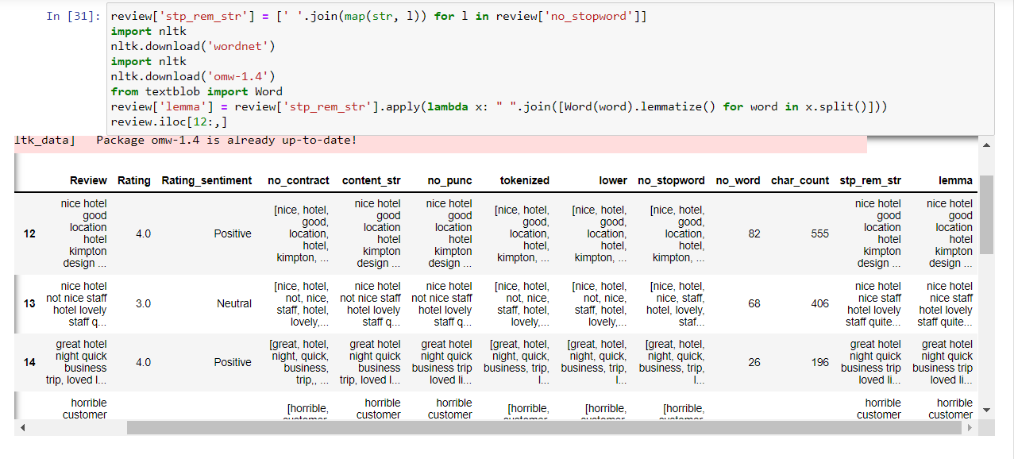
Lemmatization

Slide 10
Compare No of Words before and after cleaning
 | no_word_before_EDA | no_word_after_EDA
0 | 89 | 81
1 | 252 | 237
2 | 219 | 211
3 | 91 | 86
4 | 193 | 180
... | ... | ...
20486 | 111 | 107
20487 | 41 | 39
20488 | 65 | 61
20489 | 783 | 753
20490 | 92 | 86
As we can see here, there is reduction in the number of words after cleaning . The data pre-processing help us to eliminate unimportant/irrelevant features to reduce computational time and complexity.
In cleaning we removed punctuation marks ,hashtags ,stopwords , numbers, URL , lower the data and Lemmatization .

Slide 11
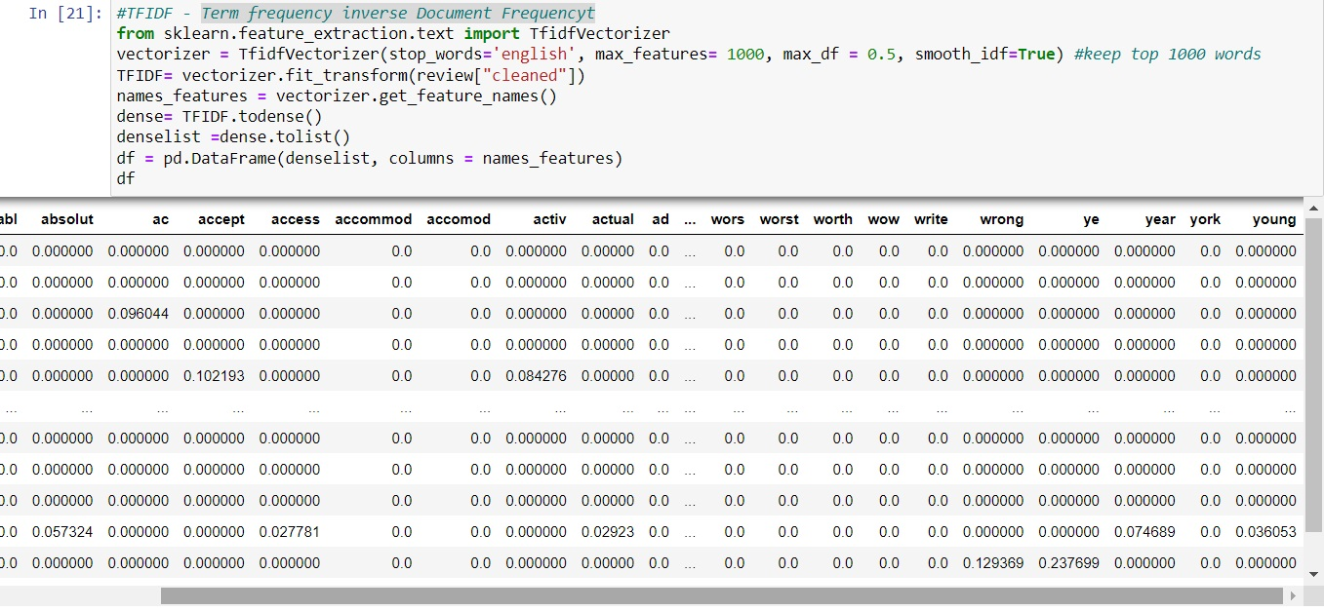
TFIDF – Term Frequency Inverse Document Frequency

Slide 12
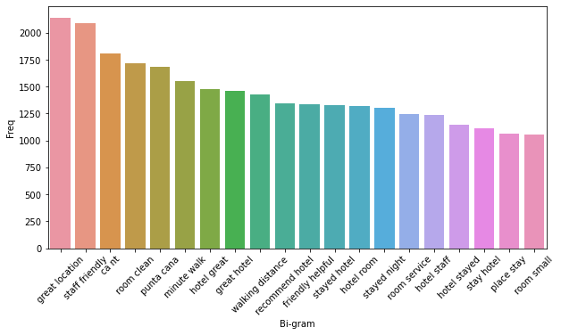
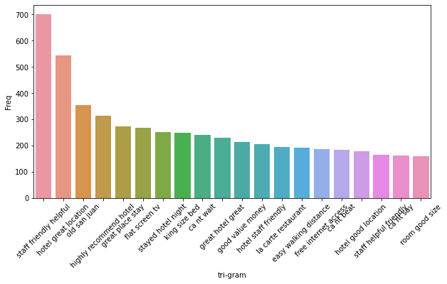
Bi - Gram
Tri -Gram
We use CountVectorizer to find most frequent Bi – Gram feature and we plot in barplot .
The some main features are great location, staff friendly, room clean etc.
Similarly ,We use CountVectorizer to find most frequent Tri – Gram feature
The some important features are staff friendly helpful ,hotel great location ,great place stay etc.

Slide 13
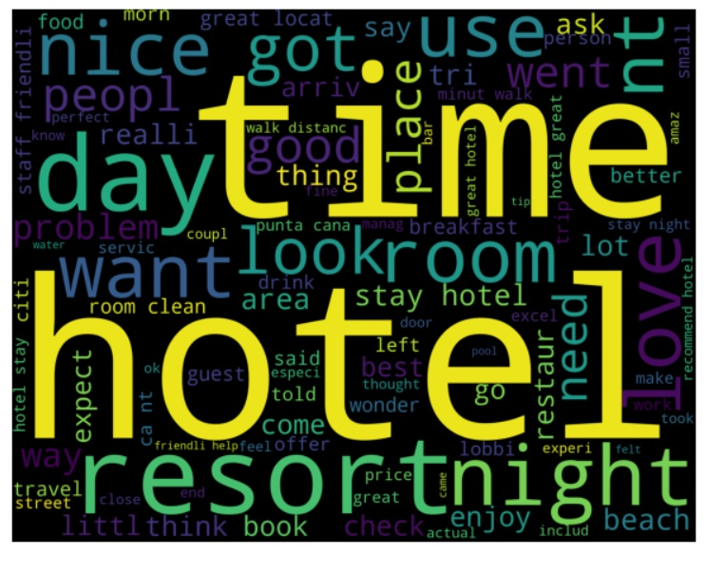
Word Cloud
Cleaned Sentences Wordcloud:

Slide 14
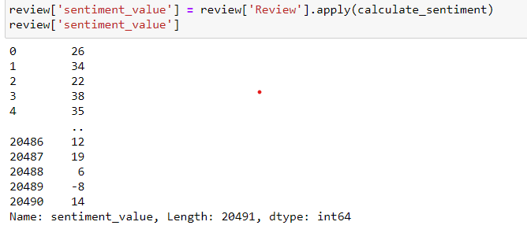
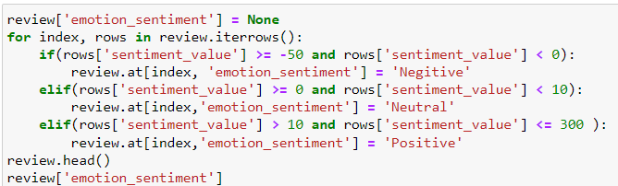
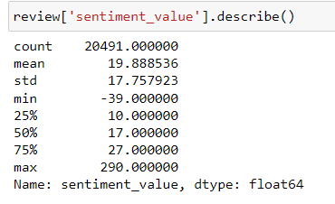
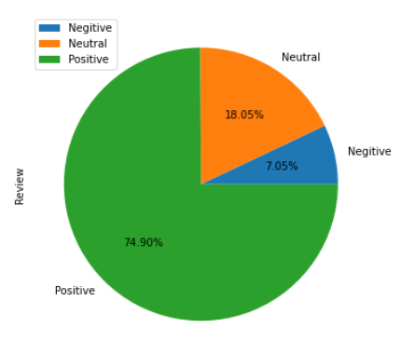
Emotion Mining
Here we have loaded Afinn dataset to get the value of each word
The minimum value of calculated sentiment score is -39 & maximum is 290
Later those values are checked with review column & to assign score for the whole original sentence.
Pie Chart : Emotion Mining

Slide 15
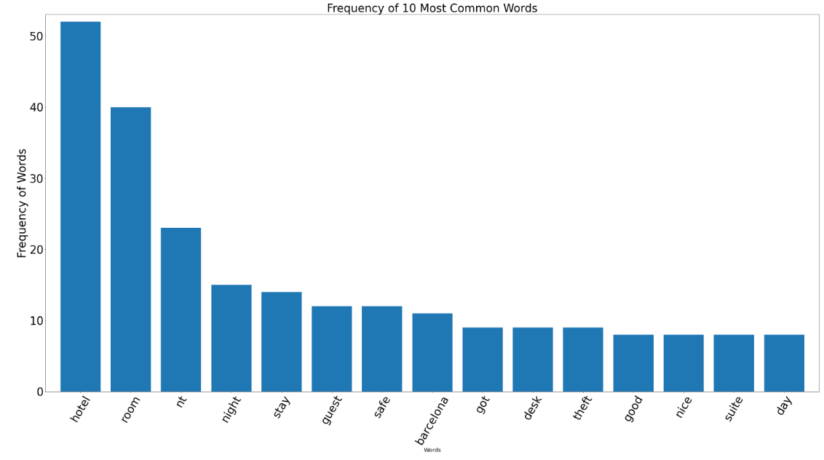

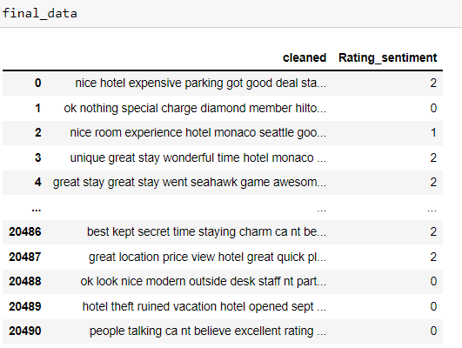
Bar Chart of Cleaned Data & Rating Sentiment
Frequency of 10 Most Common Words
Rating Sentiment

Slide 16
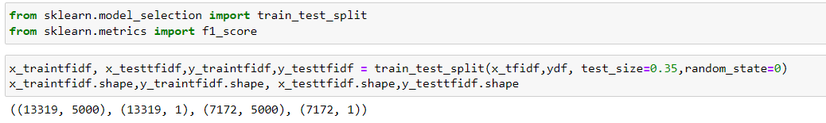
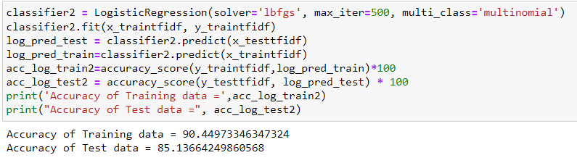
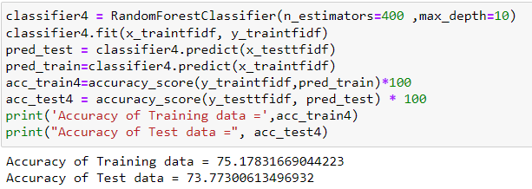
Split Data into Train & Test
Train =0.65
Test= 0.35
Implementation of Models
Logistic Regression
Random Forest Classifier

Slide 17
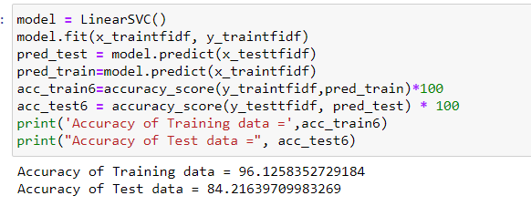
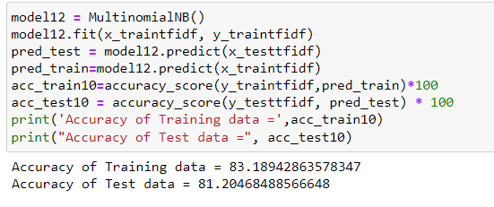
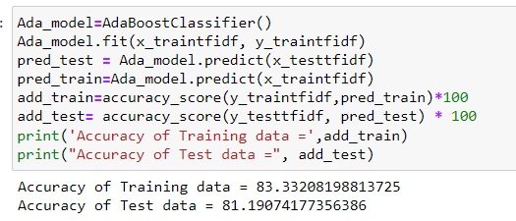
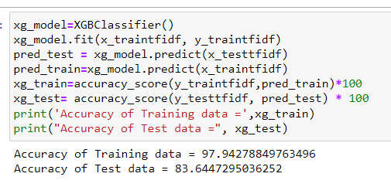
Support Vector Classifier
Multinomial Naïve Bayes
AdaBoost Classifier
XGBoost Classifier

Slide 18
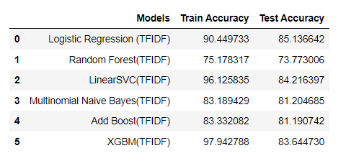
Final Table
Conclusion :
From the final table we can conclude that among the calculated classified --> Multinomial Naive Bayes Classifier gave the favorable results .

Slide 19
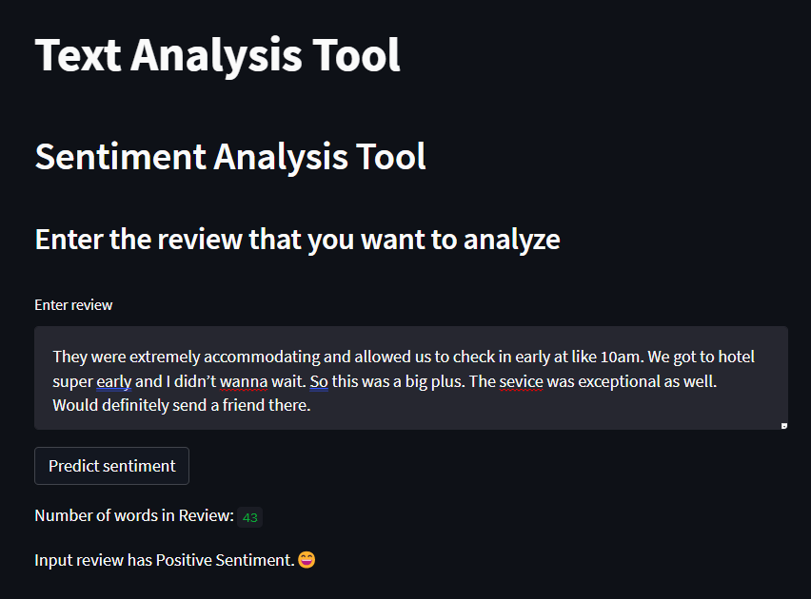
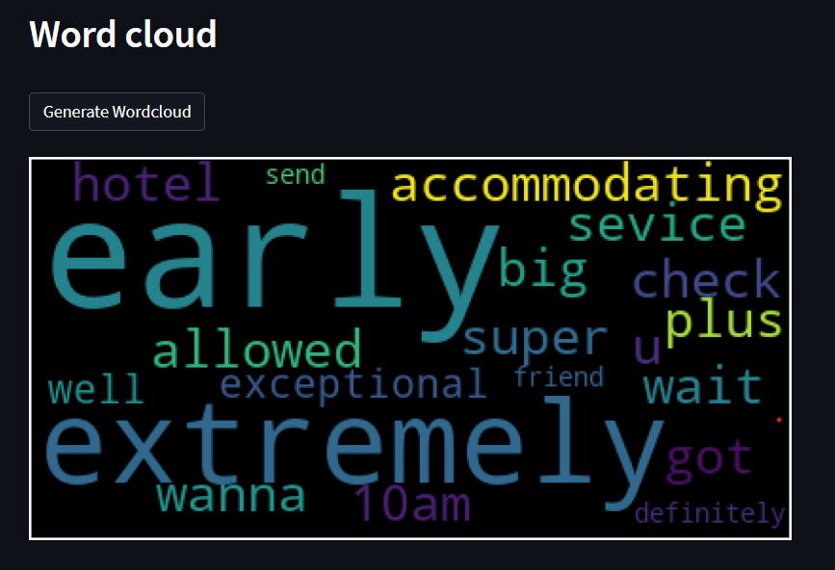
Model Deployment On Web Server :
For model deployment, we have implemented data on streamlit
1.Create .py file for deployment → Drag and Drop file
2.Open the Command Prompt
3.Run pip install streamlit
streamlit run filename.py
4.New window will open having deployment part

Slide 20
Thank You

